Slide 1

AYITI ANALYTICS BOOTCAMP, FINAL PROJECT PRESENTATION
By:
J. Max-Havel JACOB
August 13, 2020

Slide 2
Introduction
This project is about the institutions in Haiti: technical and university. This project aims above all to classify the different institutions of the country. which speciality or field is the most repeated, which commune has the greatest number of specialities, fields or types of diplomas.
Data acquisition & Cleaning
The data we worked with come from jobpaw509.com. This is a website where you can find job offers and also promote your institution such as school, university, technical training and so on. On the website the data we had to scrapped looked like this:

Slide 3
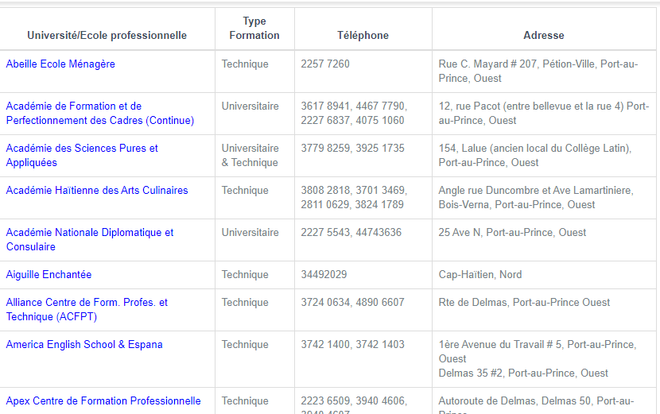

Slide 4
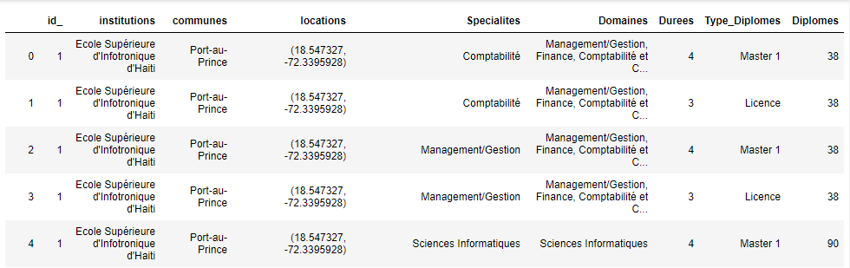
After cleaning the data, remove the null values and add new features, we obtained our final data frame.

Slide 5
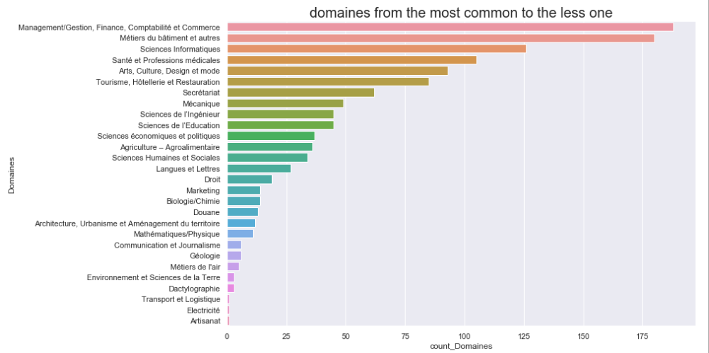
Fig 1

Slide 6
The chart above shows the fields from the most repeated one to the less repeated. The top 5 most repeated fields are:
Management/Gestion, Finance, Comptabilité et Commerce : 188
Métiers du bâtiment et autres: 180
Sciences Informatiques: 126
Santé et Professions médicales: 105
Arts, Culture, Design et mode: 93
Tourisme, Hôtellerie et Restauration: 85
Secrétariat: 62
Mécanique: 49
Sciences de l’Ingénieur: 45
Sciences de l’Education: 45

Slide 7
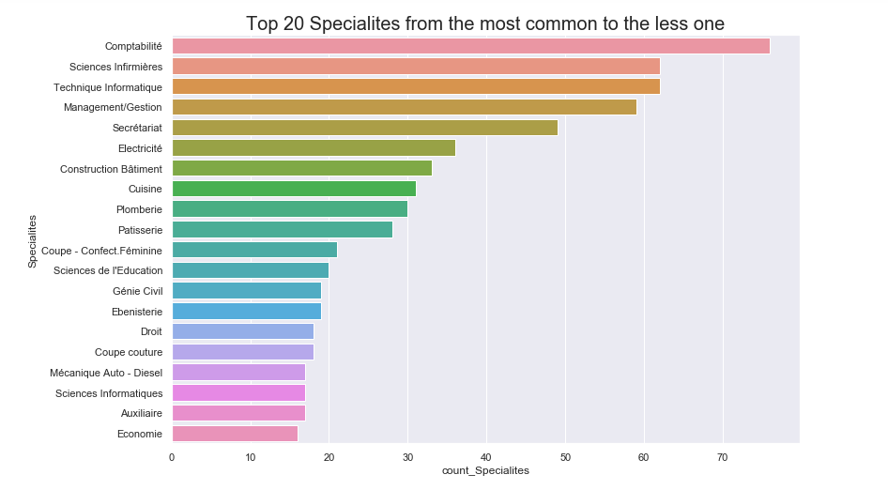
Fig 2

Slide 8
The chart above (fig 2) shows the 20 most repeated specialities . The top 5 most repeated fields are:
0 | Comptabilité | 76
1 | Sciences Infirmières | 62
2 | Technique Informatique | 62
3 | Management/Gestion | 59
4 | Secrétariat | 49

Slide 9
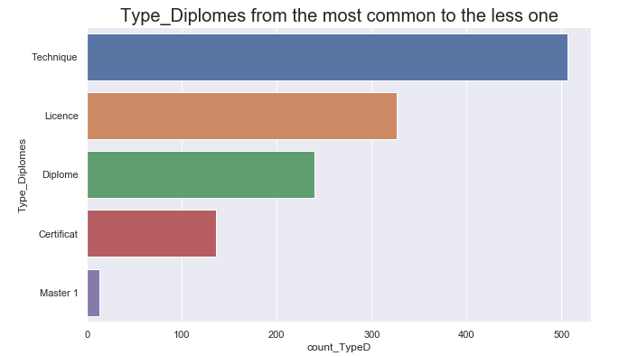
Fig 3
Fig 3 is a visualization of the type of diplomas, with a number of 506, technique is most repeated type of diploma, followed by license: 326, Diploma: 240, certificate: 136 and Master I: 13.

Slide 10
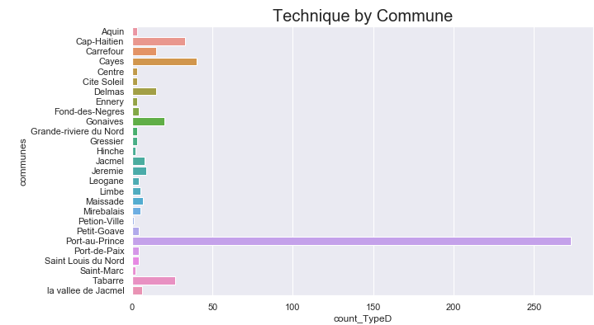
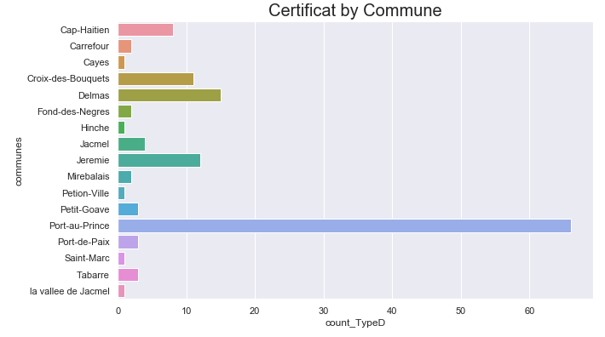
Fig 4
Fig 5

Slide 11
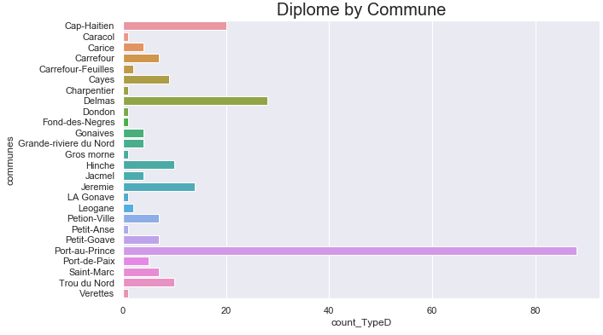
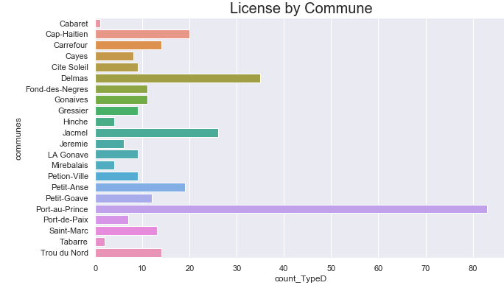
Fig 6
Fig 7

Slide 12
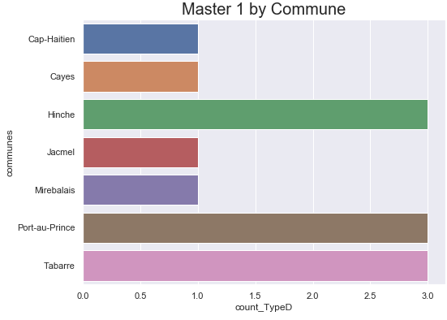
Fig 8
The figure 4, 5, 6, 7 and 8 represent the visualization of the type of diploma by department. For type of diploma like technique, certificate, diploma and license, Port-au-Prince is the commune with the most repeated programs for each type of diploma.
For the type of diploma Master I, communes Port-au-Prince, Tabarre and Hinche share the top with 3 programs of Master I each. Communes: Cap-Haitien, Cayes, Jacmel and Mirebalais have just one Master I program each.

Slide 13
Conclusion
This project helps us to have a better idea on which field and specialities the institutions in Haiti offered. This could help a student to choose in what field or speciality he or she wants to evolve. Either according to the most demanded speciality or according to an uncommon one. This project can also help organizations or individuals who want to build new institutions in the country. Thanks to this document they will be able to have access to municipalities that do not have certain specialities but are in great demand.

